Slide 1

Nested Loops
Alp KUT
Derya BİRANT
Kökten Ulaş BİRANT

Slide 2
OUTLINE
Loop Statements
  While - loop
  Do while - loop
  For - loop
Nested Loops
Examples

Slide 3
Loop Statements
Loop statements handle -controlled-repetition details
For – loop
While – loop
Do While – loop
for (initialization; loop_condition; step)
statement(s);
initialization;
while ( loop_condition )
{
statement(s);
step;
}
initialization;
do
{
statement(s);
step;
} while ( loop_condition )

Slide 4
for – while – do while
int i=1;
while (i <= 10)
{
Console.Write(i + " ");
i = i + 1;
}
1 2 3 4 5 6 7 8 9 10
int i=1;
do
{
Console.Write(i + " ");
i = i + 1;
} while (i <= 10);
for (int i = 1; i <= 10; i++)
Console.Write(i + " ");

Slide 5
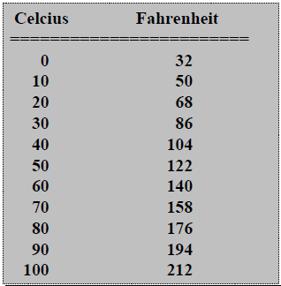

Question
Write a program that displays a table of temperatures in Celcius degrees and Fahrenheit degrees. The temperatures should be in the interval 0 to 100, with a step of 10ºC

Slide 6
Menu Handling
int option;
do {
Console.WriteLine("------------ MENU -----------");
Console.WriteLine("1 - Circle area");
Console.WriteLine("2 - Rectangle area");
Console.WriteLine("3 - Triangle area");
Console.WriteLine("4 - Quit");
Console.WriteLine("-----------------------------");
Console.WriteLine("Your option?");
option = Convert.ToInt16(Console.ReadLine());
switch (option)
{
case 1: ... break; // Circle area and perimeter
case 2: ... break; // Rectangle area
case 3: ... break; // Triangle hypotenuse
}
} while (option != 4);

Slide 7
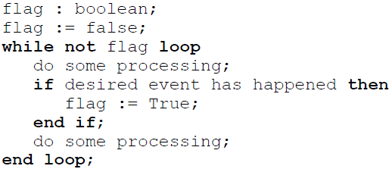
Flag-controlled Loops
A flag is a Boolean variable
  A value of False indicates that the desired event has not yet occurred
  True indicates that it has occurred

Slide 8
Flag-controlled Loops
bool flag = false;
int c;
while (!flag)
{
Console.WriteLine("Enter a digit");
c = Convert.ToInt16(Console.ReadLine());
if ((c >= 0) & (c <= 9))
flag = true;
}
Console.WriteLine("Thanks");

Slide 9
Infinite Loops
The condition of a while loop eventually must be false
If not, it is called an infinite loop, which will execute until the user interrupts the program
This is a common logical (semantic) error.
You should always double check the logic of a program to ensure that your loops will terminate normally

Slide 10
Infinite Loops
An example of an infinite loop:
int count = 1;
while (count <= 25){
Console.WriteLine(count);
count = count - 1;
}

Slide 11
Break Command
break can also be used to exit an infinite loop
int a = 1;
int count = 0;
while (a == 1)
{
if (count == 15)
break;
Console.WriteLine(count);
count = count + 1;
}

Slide 12
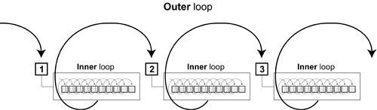
Nested Loops
When want to do something multiple times, and then do that multiple times
Examples:
  Printing a 2-dimensional table
  Printing the average mark of several exams

Slide 13
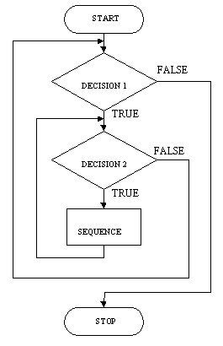
Nested Loops
A loop can contain another loop
For each iteration of the outer loop, the inner loop iterates completely
outer
loop
inner
loop

Slide 14
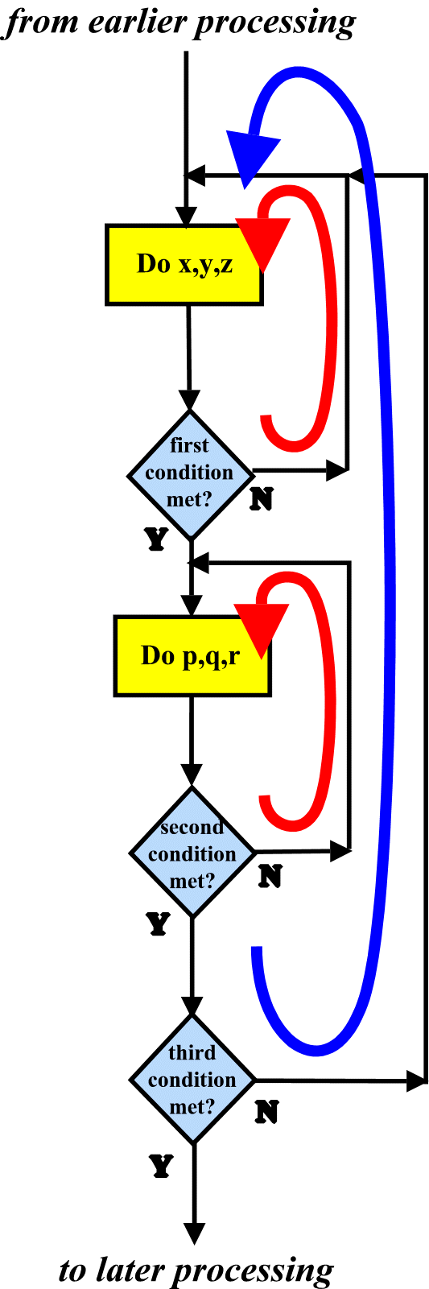
Nested Loops

Slide 15
Nested Loops
The following statement(s) is executes M * N times
for (int i = 1; i <= M; i++) {
for (int j = 1; j <= N; j++)
statement(s);
}
The following statement(s) is executes M * N * T times
for (int i = 1; i <= M; i++) {
for (int j = 1; j <= N; j++)
for (int k = 1; k <= T; k++)
statement(s);
}

Slide 16
Nested Loop Example
How many times will the string "Here" be printed?
count1 = 1;
while (count1 <= 10){
count2 = 1;
while (count2 <= 20) {
Console.WriteLine("here");
count2++;
}
count1++;
}
10 * 20 = 200

Slide 17
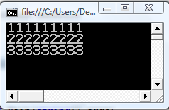
Example
What is the output of the following program?
for (int i = 1; i <= 3; i++)
{
for (int j = 1; j <= 9; j++)
Console.Write(i);
Console.WriteLine();
}

Slide 18
Example
Print the following two-dimensional table
1 2 3 4 5
1 2 3 4 5
1 2 3 4 5
i j
1 1
1 2
1 3
1 4
1 5
2 1
2 2
2 3
2 4
2 5
3 1
3 2
3 3
3 4
3 5
for (int i = 1; i <= 3; i++) {
for (int j = 1; j <= 5; j++)
Console.Write(j + " ");
Console.WriteLine();
}

Slide 19
Example
Write a program that prints the following output:
*****
*****
*****
for (int i = 1; i <= 3; i++) {
for (int j = 1; j <= 5; j++)
Console.Write("*");
Console.WriteLine();
}

Slide 20
Example
Write a program that prints the following output:
*
**
***
****
*****
for (int i = 1; i <= 5; i++) {
for (int j = 1; j <= i; j++)
Console.Write("*");
Console.WriteLine();
}

Slide 21
Example
Write a program that prints the following output:
*******
*****
***
*
int yildiz_sayisi = 7;
int bosluk_sayisi = 0;
for (int i = 1; i <= 4; i++)
{
for (int j = 1; j <= bosluk_sayisi; j++)
Console.Write(" ");
for (int j = 1; j <= yildiz_sayisi; j++)
Console.Write("*");
Console.WriteLine();
yildiz_sayisi = yildiz_sayisi - 2;
bosluk_sayisi = bosluk_sayisi + 2;
}

Slide 22

 
 
 
 
 
 


